Slide 1
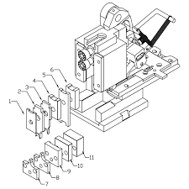
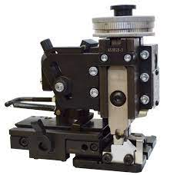
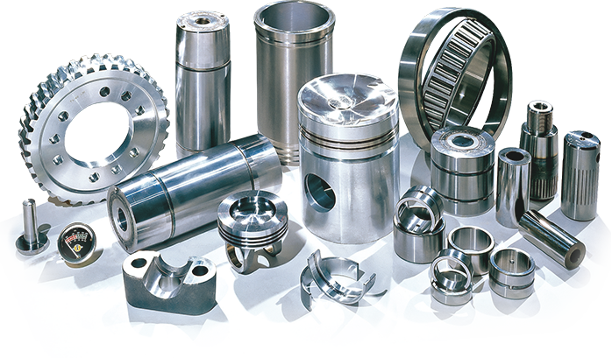
Tool Parts Store
A store of tool spare parts

Slide 2
Main actors in the app
Normal user : (maintenance department)
Needs to know information about the spare part that he want to get.
Admin : (magasin pièce de rechange)
Holds the privilege of adding new parts to the store
Can access the list of users and delete any of them

